Slide 1
Road Accident Analysis Using Machine Learning
Batch 2
V Viswa - RA1911026020076
K Naveen Chaitanya – RA1911026020090
M Naveen – RA1911026020103

Slide 2
Introduction
Road Accident is the most undesirable and unexpected thing to occur to a road user, though they happen quite often. It has a massive impact on society as well as in the economy of our country as there is an immense cost of fatalities and injuries. Annually on an average 12,000 lives have been taken by road accidents and lead to almost 35,000 injuries. This record indicates that every day, approximately 32 people were killed in India by road accidents and it is quite devastating. Besides this, according to WHO, the economic cost of road accidents to a developing country like us is 2-3% of GDP, which is a significant loss for a country like ours. Moreover, reducing this loss has become a great matter of concern for our country now. To combat against this we propose a study to analyze road accidents using Machine learning by scrutinizing accident prone areas and finding their root causes.

Slide 3
Abstract
Accidents through roadways have been a great threat to developed as well as underdeveloped countries. Road accidents and its safety have been a major concern for the world, and everyone is trying to handle this since years. Road traffic and reckless driving occur in every part of the world. Because of this, many pedestrians are affected too. With no fault, they become victims. Many road accidents occur because of numerous factors like atmospheric changes, sharp curves, and human faults. Injuries caused by road accidents are major but sometimes imperceptible, which later on affect health too. This study aims to analyze road accidents in one of the popular metropolitan cities, through k-means algorithm and machine learning by scrutinizing accident-prone or hotspot areas and their root causes.

Slide 4
Project Statement
Finding accurate and reliable technique or method through which extraction of data and information can be analyzed effectively and efficiently through the provided data set by concerned authorities. In this research work we focused on finding accident patterns in road accidents based on causes using various classification algorithms.

Slide 5
Existing System
Sachin Kumar :-
Used data mining techniques to identify the locations where high frequency accidents are occurred and then analyses them to identify the factors that have an effect on road accidents at that locations. The first task is to divide the accident location into k groups using the k-means clustering algorithm based on road accident frequency counts. Then, association rule mining algorithm applied in order to find out the relationship between distinct attributes which are in accident data set and according to that know the characteristics of location.
S Shanthi :-
Proposed data mining classification technology based on gender classification, in which RndTree and C4.S use AdaBoost Meta classifier to provide high-precision results. From the Critical Analysis Reporting Environment (CARE) system provided by the Fatal Analysis Reporting System (FARS) used by the training data set.

Slide 6
Objective
To find the road accident patterns using various classification algorithms.
To study Data Mining Techniques, and how information can be extracted from the raw data.
To find a robust, reliable and accurate technique or classifier for better understanding accident patterns and predicting them.

Slide 7
Literature Survey - Road Accident Analysis Using Machine Learning

Slide 8
Survey - 1
S. No. | Title | Author name, Journal name, year | Objective | Name of the techniques used and dataset | Limitation
1 | Using Machine Learning to Predict Car Accident Risk | Daniel Wilson, medium.com, 2018 Link: https://medium.com/geoai/using-machine-learning-to-predict-car-accident-risk-4d92c91a7d57 | Making use of machine learning to save lives and prevent accidents. | Dataset: Static features Weather Time features Speed limit Road curvature Average traffic volumes etc. Techniques used: ArcGIS platform (location-focused platform-as-a-service - (PaaS)) | As this theory is published on considering Static features, real time traffic information in which we can plan better routes is not recorded.

Slide 9
Survey - 2
S. No. | Title | Author name, Journal name, year | Objective | Name of the techniques used and dataset | Limitation
1 | Analyzing road accident data using machine learning paradigms | 1) Priyanka A. Nandurge, 2) Nagaraj V. Dharawadkar IEEE, 2017 | To determine the main factors associated with road traffic accidents and to prevent them accordingly. | Dataset: Time Number injured Light condition Weather condition Type of area Road type, etc. Techniques used: K-means clustering and association | It requires to specify the number of clusters (k) in advance and It can not handle noisy data and outliers.

Slide 10
Survey - 3
S. No. | Title | Author name, Journal name, year | Objective | Name of the techniques used and dataset | Limitation
1 | Development of traffic accident prediction models by traffic and road characteristics in urban areas. | Dahee Hong, Citeseerx.ist.psu.edu, 2012 Link: https://citeseerx.ist.psu.edu/viewdoc/download?doi=10.1.1.563.2040&rep=rep1&type=pdf | To develop accident prediction model that reduces the risk of accidents by physical characteristics of road types through a survey of characteristics of roads and accidents in urban areas. | Dataset: Road type Number of accidents/km Number of Intersections Number of Connection roads Traffic Volume Number of injured/km Number of death/km Techniques used: Calculation mechanisms using the above datasets. | This survey does not use any modern use cases like geo location, weather, speed of vehicle etc.,. that are main reasons for the cause of accidents.

Slide 11
Survey - 4
S. No. | Title | Author name, Journal name, year | Objective | Name of the techniques used and dataset | Limitation
1. | Road Accident Analysis and Prediction of Accident Severity by Using Machine Learning | Md. Farhan Labib, Ahmed Sady Rifat, Md. Mosabbir Hossain, Amit Kumar Das, Faria Nawrine. 7th International Conference on Smart Computing & Communications (ICSCC ), 2019 | This research paper has been done to analyze traffic accidents more deeply to determine the intensity of accidents by using machine learning | DATA SET 1.Accident Severity 2.Weight 3.Vehicle type 4.Road Geometry 5.Divider 6.Location type Techniques used Decision Tree, K-Nearest Neighbors (KNN), Naïve Bayes and AdaBoost

Slide 12
Survey - 5
S. No. | Title | Author name, Journal name, year | Objective | Name of the techniques used and dataset | Limitation
1. | A Framework for Analysis of Road Accidents using machine learning | Shristi Sonal Saumya Suman. Proceedings International Conference on Emerging Trends and Innovations in Engineering and Technological Research (ICETIETR) 2018. | The road accident data analysis use data mining and machine learning techniques, focusing on identifying factors that affect the severity of an accident. | Dataset 1.No. of victims 2.Date of accident 3.Time of accident 4.Road type 5.Weather 6.condition 7.Lighting on road 8.Accident severity 9.Age group Techniques used a powerful N-dimensional array object,R programming language •

Slide 13
Survey - 6.
S. No. | Title | Author name, Journal name, year | Objective | Name of the techniques used and dataset | Limitation
1. | Towards Deep Learning based Traffic Accident Analysis | AtifNaseer Mohamed K. Nour Basem Y. Alkazemi | This paper proposes applying deep learning techniques to build prediction and classification models from the road accident data | DATA SET 1.traffic accident data 2.road condition 3.weather condition 4.pedestrain factor Techniques used Classification, Regression, Association Rules, and Clustering related algorithms,recurrent neural network

Slide 14
Survey - 7
S. No. | Title | Author name, Journal name, year | Objective | Name of the techniques used and dataset | Limitation
1. | TRAFFIC ACCIDENTS BASED ON MACHINE LEARNING | Xinman Zhanga , Tingting Hea , Longbin Lua , Shuangling Yuea , Dongxu Chenga , Xuebin Xub 2017 International Symposium on Intelligent Signal Processing and Communication Systems, November 6-9, 2017, Xiamen, China | This paper introduces a novel vehicle tracking method basedprojection extremelearning machine(PELM) by taking consideration of poorperformance in the dealing with high-dimensional and low-samples | Dataset 1.Vehicle Trajectories 2.Target Tracking 3.. Analysis on Vehicle collision 4.projection extreme learning machine Techniques used Gaussian mixture model,Tracking Algorithm Based on PELM

Slide 15
Survey - 8
S. No. | Title | Author name, Journal name, year | Objective | Name of the techniques used and dataset | Limitation
1. | Classification of Road Traffic Accident Data Using Machine Learning Algorithms | Bulbula Kumeda, Fengli Zhang, Fan Zhou. IEEE 11th International Conference on Communication Software and Network 2019 | The main targets of this roadaccidentdata classification are to identify the major and key factors that cause the road traffic accident anformpolicies andpreventiveactions that would reduce the accident severity level. | Dataset 1.No of Vehicles 2.Road Surface 3.Light Condition 4.Type of Vehicle Techniques used Fuzzy-FARCHD, Random Forest, Hierarchal LVQ, RBF Network, Multilayer Perceptron, and Naïve Baye,classification algorithms

Slide 16
Survey - 9
S. No. | Title | Author name, Journal name, year | Objective | Name of the techniques used and dataset | Limitation
1. | Analyzing Road Accident Data using Machine Learning | Dharwadkar, S.SHANTHI International conference on I-SMAC (IoT in Social, Mobile, Analytics and Cloud) (I-SMAC 2017) | Determine the main factors associated with road traffic accidents and to prevent them accordingly | Dataset: Time Number injured Light condition Weather condition Type of area Road type, etc. Techniques used: K-means clustering and association

Slide 17
Survey - 10
S. No. | Title | Author name, Journal name, year | Objective | Name of the techniques used and dataset | Limitation
1. | Machine Learning Approach to Prediction of Passenger Injuries on Real Road Situation | Yongbeom Lee, Eungi Cho, Mingyu Park. National Research Foundation of Korea(NRF) grant funded by the Korea government(MSIP; Ministry of Science, ICT & Future Planning) 2018 | In the paper, we propose a model for prediction of the severity of traffic accident injuries applicable to the automatic notification system of traffic accidents. | Dataset: 1.The details of a crash 2.The components of a harmful event 3.vehicle information 4.General occupant information 5.Occupant injury information Techniques used NASS-CDS, machine learning, decision tree, prediction of injury grade

Slide 18
Survey - 11
S. No. | Title | Author name, Journal name, year | Objective | Name of the techniques used and dataset | Limitation
1. | Prediction of Road Accident and Severity of Applying Machine Learning Techniques | Joy Paul,Zerin Jahan,Kazi Fahim Lateef,Md. RobiulIslam,Sagor ChandroBakchy 020 IEEE 8th R10Humanitarian TechnologyConference (R10-HTC) | 978-172811110-0/20/$31.00©2020IEEEDOI10.1109/R10HTC49770.2020.9356987 | Prior work on this issue mainly focused on either the possibility of an accident or the degree of severity. Some works showed low accuracy due to deficiency in record which is a major problem | DATA SET 1.Accident Severity 2.Weight 3.Vehicle type 4.Road Geometry 5.Divider 6.Location type Techniques used Decision Tree, K-Nearest Neighbors (KNN), Naïve

Slide 19
Survey - 12
S. No. | Title | Author name, Journal name, year | Objective | Name of the techniques used and dataset | Limitation
1 | Road Accident Analysis and Hotspot Prediction using Clustering | Jayesh Patil Vaibhav Patil Dhaval Walavalkar Vivian Brian Lobo 021 6th International Conference on Communication and Electronics Systems (ICCES) 2009 | This tech era,everything isalmostbecomingpossible.Machinelearning is used to analyze variousalgorithmsthroughexperienceandimproveresultsincludes three major typeofearningtechniques,namelsupervised,unsupervsed,andreinforcementlearning | DATA SET 1.Accident-prone areas 2. Condition of vehicle 3.Traffic conditions Techniques used k-means clustering algorithm; Machine learning; potholes; prediction model; unsupervised learning

Slide 20
Survey - 13
S. No. | Title | Author name, Journal name, year | Objective | Name of the techniques used and dataset | Limitation
1. | Indian Road Conditions and Accident Risk Predictions using Deep Learning | P. Navin Elamparithi Partheeban Pachaivannan Rani Hemamalini Ranganathan | Variousfactors lead to road accidents and hencestrongmethodology and the support of computer-aided supportisrequired to solve such criticalproblems. Thecurrentwork deals with the applicationofthedeeplearningapproachtopredictcritial road accidents. | DATA SET 1.Accident Severity 2.Weight 3.Vehicle type 4.Road Geometry 5.Divider 6.Location type Techniques used Neural Network,Deep learning.

Slide 21
Survey - 14
S. No. | Title | Author name, Journal name, year | Objective | Name of the techniques used and dataset | Limitation
1. | Road Accident Analysis using Machine Learning | Jayesh Pati, Vivian Brian Lobo, Mandar Prabhu | This study aims to analyze road accidents in one of the popular metropolitan cities, i.e., Bengaluru,throughkmeansalgorithm and machinelearning byscrutinizing accident-prone or hotspot areas and their root causes | DATA SET 1.Latitude, longitude, and 2.location name 3._x0002_ Speed 4._x0002_ Time 5._x0002_ Alarm type 6._x0002_ Weather 7._x0002_ Peak hour timings 8._x0002_ Potholes 9._x0002_ Accident-prone areas Techniques used k-means algorithm,clustering algorithm

Slide 22
Proposed System
Models are created using accident data records which can help to understand the characteristics of many features like latitude, longitude, roadway conditions, light condition, weather conditions, road side and so on. Machine learning will help to train the model. Model is trained by using decision tree after training helps to predict the severity.
It can be illustrated how statistical method based on directed graphs, by comparing two scenarios based on out-of-sample forecasts. The model is performed to identify statistically significant factors which can be able to predict the probabilities of crashes and injury that can be used to perform a risk factor and reduce it.

Slide 23
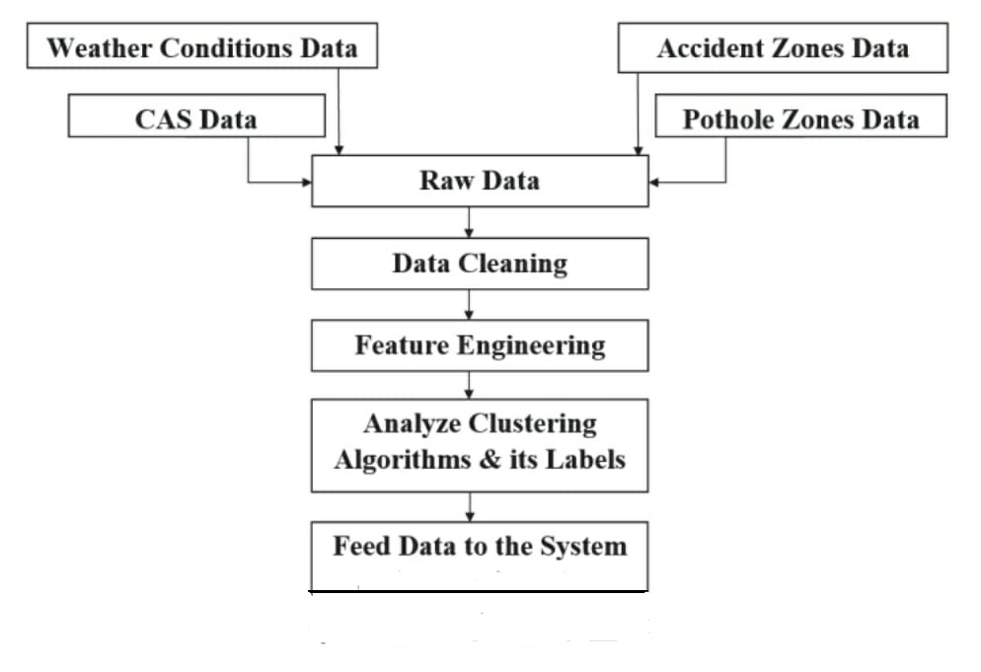
Architecture Diagram

Slide 24
Algorithms Used
K – means algorithm :-
It groups the unlabeled dataset into different clusters. It allows us to cluster the data into different groups and a convenient way to discover the categories of groups in the unlabeled dataset on its own without the need for any training

Slide 25
Module Description
Data Mining module :- The module aims to provide concepts underlying data
mining and algorithms commonly used in data mining tools.
It transforms raw data into useful information and actionable
knowledge.
Android Application
module :- It contains a user model where the location of the place
uploading images, and analysis is done. The location of the
place is acquired by using GPS. The latitude and longitude
is stored in the database server. Such that, images of the
potholes are also stored. They are alerted with a message
about the road conditions so that they can take measures
while travelling.

Slide 26
Future Enhancement
Within the techniques and algorithms reviewed, Geographic data set can be highlighted
to increase the accuracy to classify data.
This research did not use any deep learning techniques, so they can be used to predict
road traffic accidents with high precision.
Road infrastructure, weather conditions and demographic information needs to be updated
till date.
Use of neural networks comes with great precision, so that can be a novel approach to this
project.

Slide 27
Conclusion
ML has been helping us to solve many problems in our day-to-day life. It has helped to analyze
data provided and provide appropriate solutions to problems that occur. Due to which, the
study uses k-means algorithm. This study aimed to determine the reason behind the major
cause of the increase in the number of road accidents happening around. For the past few
years, it was noticed that the rate of road accidents had been increasing at an alarming rate
due to various factors like drunk driving, problems related to climate, human error, etc.
Considering this, the study of road accidents can play an important role to prevent road
accidents that would have happened in the near future

